Slide 1
Analysis of Poverty and Unemployment
Prepared by: Prakhar Khandelwal
Prachi Saini

Slide 2
Introduction
Poverty and Unemployment are two critical socio-economic indicators that directly affect a nation’s growth and development.
• Poverty reflects the inability of individuals to meet basic living standards • Unemployment represents the lack of job opportunities within an economy
Understanding the relationship between these indicators helps governments and policymakers design effective economic and social welfare programs.

Slide 3
Problem Statement
Despite economic development, many regions continue to experience high levels of poverty and unemployment.
Problem Addressed: • Understanding the relationship between poverty and unemployment • Identifying trends and patterns across regions and time • Using data-driven analysis to support policy-level decisions

Slide 4
Objectives
The main objectives of this project are:
• To perform Exploratory Data Analysis (EDA) on poverty and unemployment data • To analyze the correlation between poverty and unemployment • To visualize trends using an interactive Power BI dashboard • To derive meaningful insights from data analysis

Slide 5
Dataset Description
• Source: Kaggle • Time Period: [2018 to 2023] • Number of Records: [701]
Key Variables: • Poverty Rate • Unemployment Rate • Region / Country • Year

Slide 6
Tools & Technologies Used
Python: • Used for data cleaning, EDA, and correlation analysis • Libraries:
Pandas
NumPy
Matplotlib
Seaborn
Power BI: • Used for creating interactive dashboards • Visual representation of trends and KPIs

Slide 7
Methodology
Project Workflow:
Data Collection
Data Cleaning & Preprocessing
Exploratory Data Analysis (EDA)
Correlation & Regression Analysis
Power BI Dashboard Creation
Insights & Conclusion

Slide 8
Data Cleaning & Pre-processing
Data Cleaning Steps:
• Handled missing and null values • Corrected data types • Removed duplicate records • Selected relevant features for analysis
This ensured data accuracy and consistency for further analysis.

Slide 9
Exploratory Data Analysis
There are different Charts used for the better insights for analysis.
Bar Chart – Average Population by State
Line Chart – Poverty Rate Over Time
Bar Chart – Poverty Rate by top 10 State
Box Plot – Poverty Rate
Scatter Chart – GDP Vs Poverty Rate

Slide 10
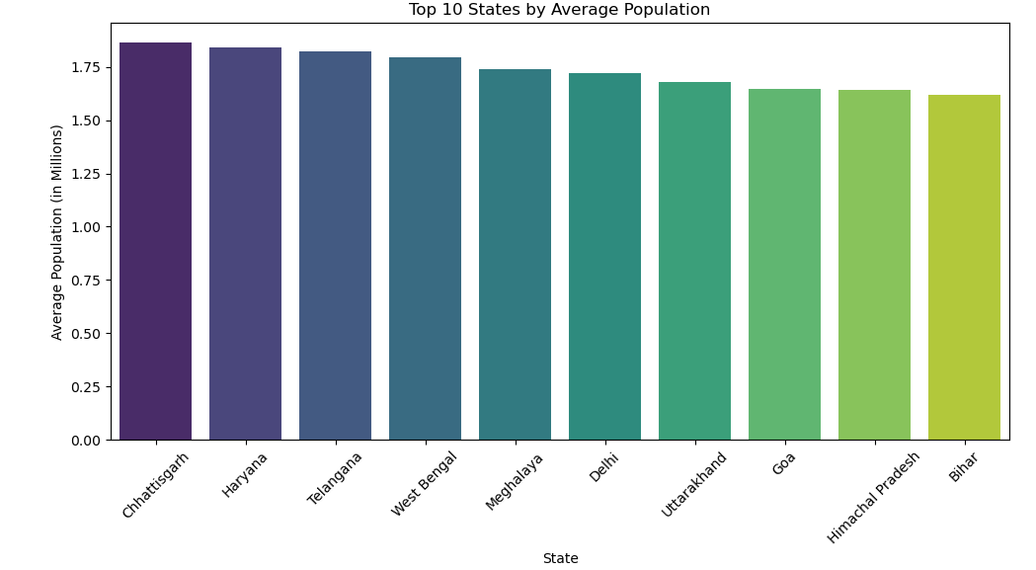
Bar Chart – Average Population by State
Chhattisgarh has the highest average population among the listed states.
Haryana and Telangana closely follow, indicating relatively higher population concentration.
Bihar, Himachal Pradesh, and Goa are on the lower end among the top 10.
The population values are fairly close (roughly between 1.6–1.9 million), suggesting no extreme population disparity among these states.
The distribution indicates moderate population balance, rather than dominance by one state.

Slide 11
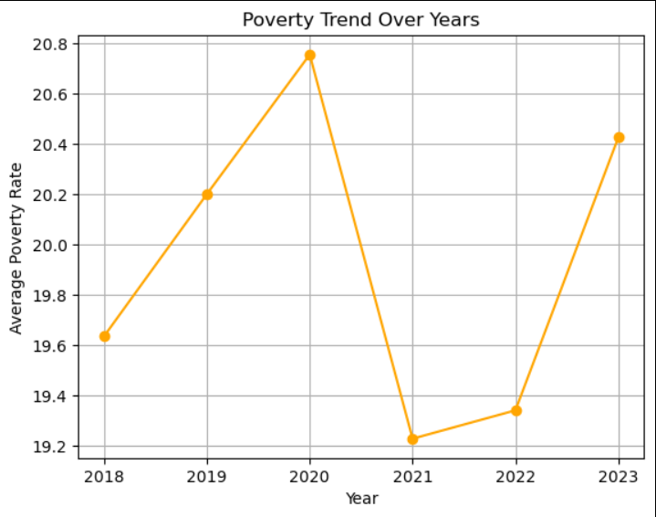
Line Chart – Poverty Rate Over Time
This chart illustrates the trend of poverty over time, showing whether poverty levels are increasing or decreasing.

Slide 12
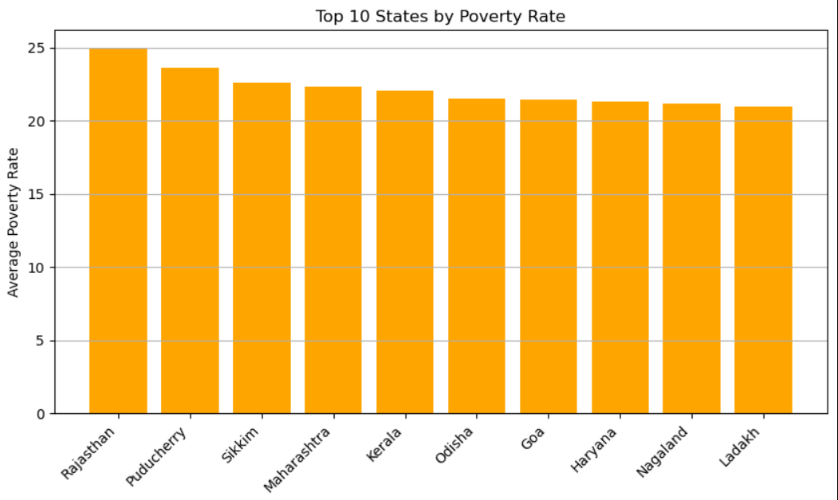
Bar Chart – Poverty Rate by top 10 State
Compares average poverty levels across regions, identifying high-poverty areas.

Slide 13
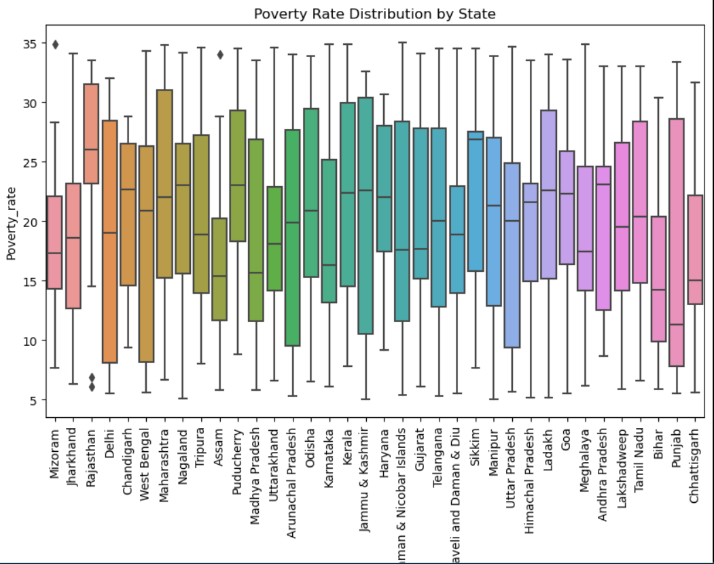
Box Plot – Poverty Rate
The box plot highlights the median, spread, and outliers in poverty data, identifying regions with unusually high or low poverty.

Slide 14
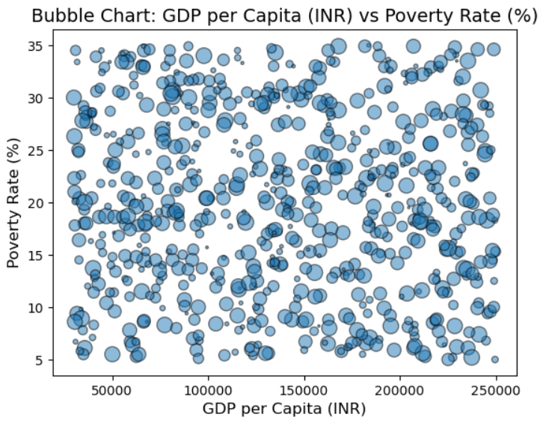
Scatter Chart – GDP Vs Poverty Rate
The chart shows that higher GDP per capita doesn’t guarantee a lower poverty rate, indicating that economic growth alone may not be sufficient to reduce poverty without complementary social policies.

Slide 15
Correlation Analysis
Correlation Analysis:
• Method Used: Pearson Correlation
Visualization: • Scatter Plot • Heatmap
Interpretation: • Indicates a positive relationship between poverty and unemployment • As unemployment increases, poverty tends to rise

Slide 16
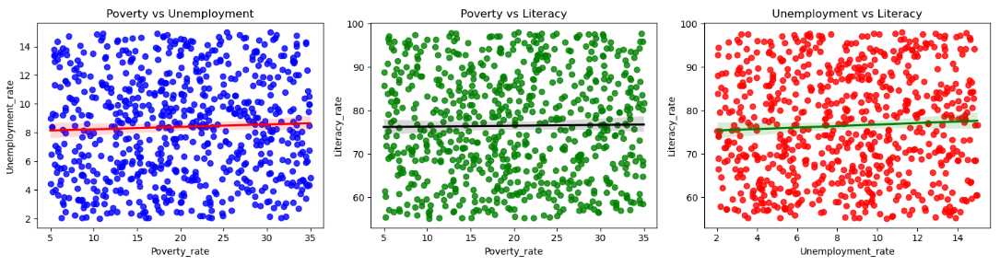
Scatter Plot Chart
The scatter plots show no clear linear relationship among poverty, unemployment, and literacy – the points are widely dispersed, suggesting that each variable likely interacts with other unseen factors rather than directly influencing one another in a simple way.

Slide 17
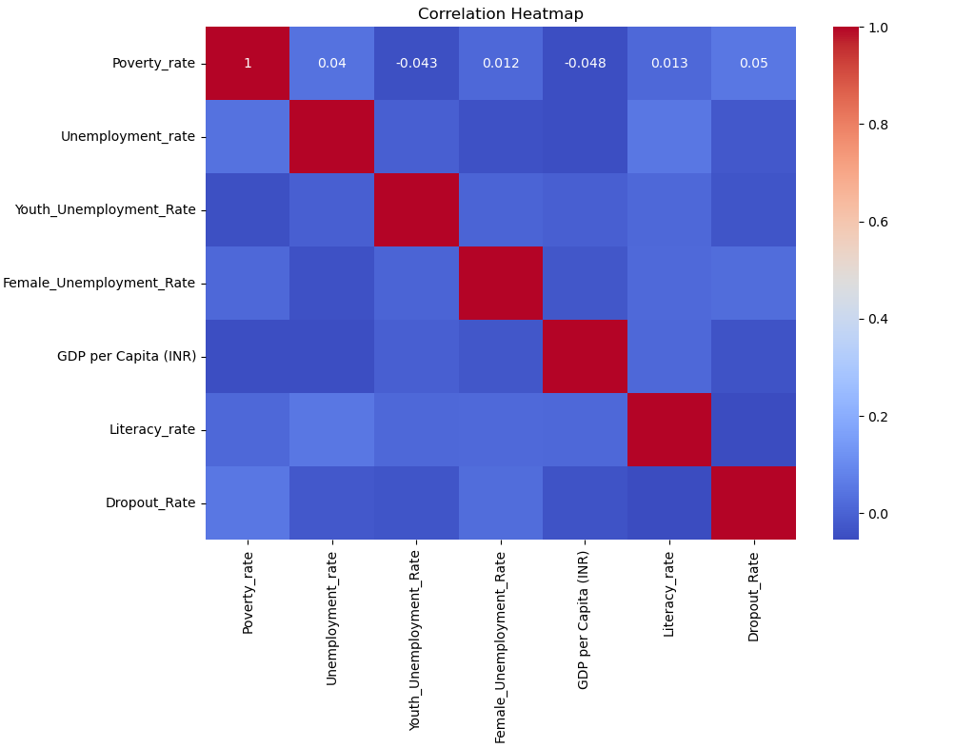
Correlation Heatmap
The heatmap displays the strength and direction of correlation between poverty and unemployment using color intensity.

Slide 18
Key Insights from Python Analysis
• Poverty and unemployment are positively correlated. • Certain regions consistently show higher poverty levels. • Economic conditions vary significantly across years • Regions with high unemployment tend to experience higher poverty.

Slide 19
Power BI Dashboard Overview
Dashboard Features:
Interactive KPIs for Poverty & Unemployment
Filters:
Year
Region
Dynamic charts and visuals

Slide 20
Dashboard Insights
Key Metrics insights
The average GDP per capita stands at ₹137.61K, indicating moderate economic output.
Despite this, poverty (19.92%) and unemployment (8.39%) remain significant concerns.
Youth unemployment is notably higher at 14.89%, highlighting employment challenges for younger populations.
Charts Insights
Relationship Between Poverty and Unemployment(Scatter plot)
The scatter plot shows a wide dispersion with no strong linear relationship between poverty and unemployment.
This suggests that unemployment alone does not fully explain poverty levels, and other factors such as education, sectoral employment, and regional development play a role.

Slide 21
GDP vs Poverty Trend(Scatter plot)
The GDP vs Poverty plot indicates an inverse relationship.
Regions with higher GDP per capita generally show lower poverty rates, reinforcing the importance of economic growth in poverty reduction.
State-Wise Poverty Distribution(Bar Chart)
Significant variation exists across states.
Himachal Pradesh shows the lowest poverty levels, while Jammu & Kashmir records the highest, pointing to strong regional disparities that require targeted policy interventions.

Slide 22
4. Education Trends: Enrollment vs Dropout(Bar & Line Chart)
School enrollment remains relatively stable between 40%–60% from 2018 to 2022.
Dropout rates declined until 2020 but rose again to 11% by 2022, indicating post-pandemic challenges in retaining students.
Rising dropout rates may negatively impact future employment and poverty outcomes.
5. Unemployment Trend Over Time(Line Chart)
Unemployment increased steadily from 2018, peaking in 2021, likely due to economic disruptions.
A decline in 2022 suggests early signs of recovery, though levels remain elevated compared to pre-2019.

Slide 23
6. Employment Structure by Sector(Pie Chart)
Services (39.27%) employ the largest share of the workforce, followed closely by Agriculture (36.79%).
The economy is transitioning toward services, but a large dependency on agriculture indicates vulnerability to income instability.
Overall Conclusion
Economic growth alone is insufficient; job creation, education retention, and youth employment must be prioritized.
Addressing regional disparities and strengthening the services sector can significantly reduce poverty and unemployment in the long term.

Slide 24
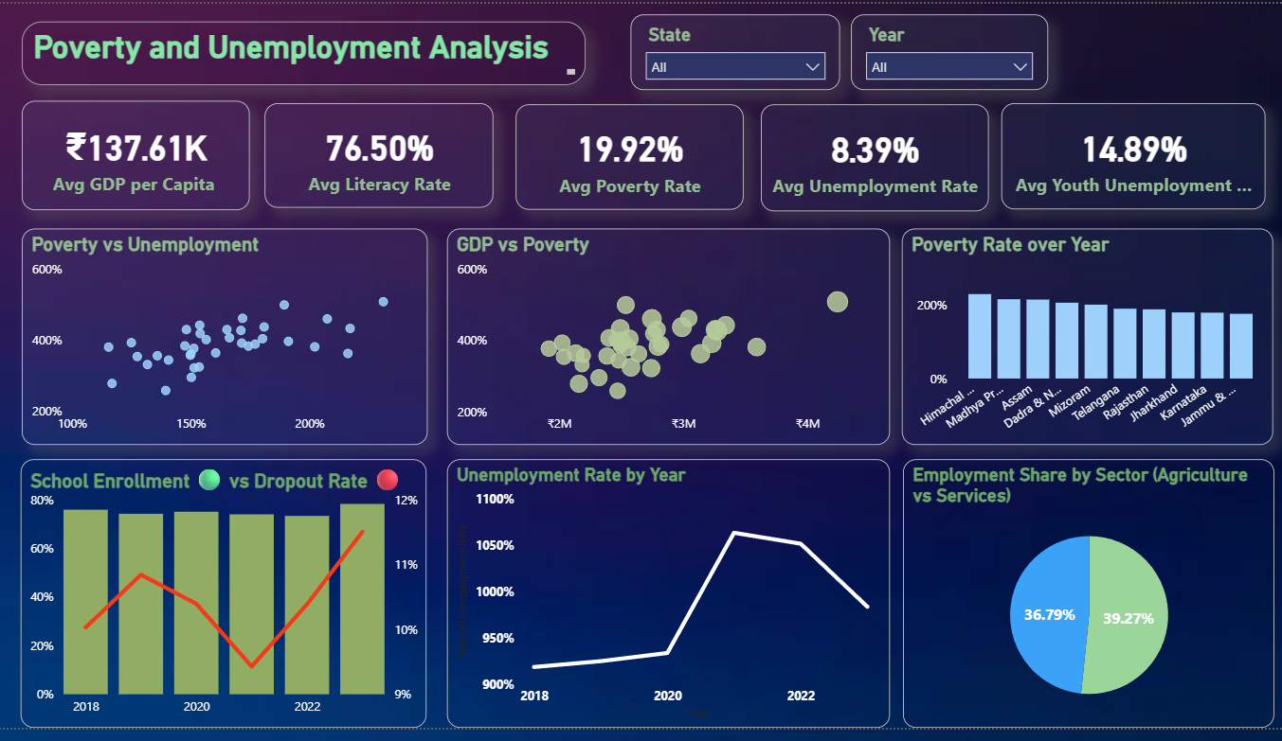

Slide 25
Conclusion
• Poverty and unemployment are closely related socio-economic issues • Data analysis confirms a strong relationship between them • Python and Power BI together provide powerful analytical insights • The study supports informed decision-making

Slide 26
Recommendations
Employment generation programs in high-risk regions
Skill development and education initiatives
Targeted poverty reduction policies
Use of data analytics for policy planning

Slide 27
Thank You
Thank You

